Slide 1
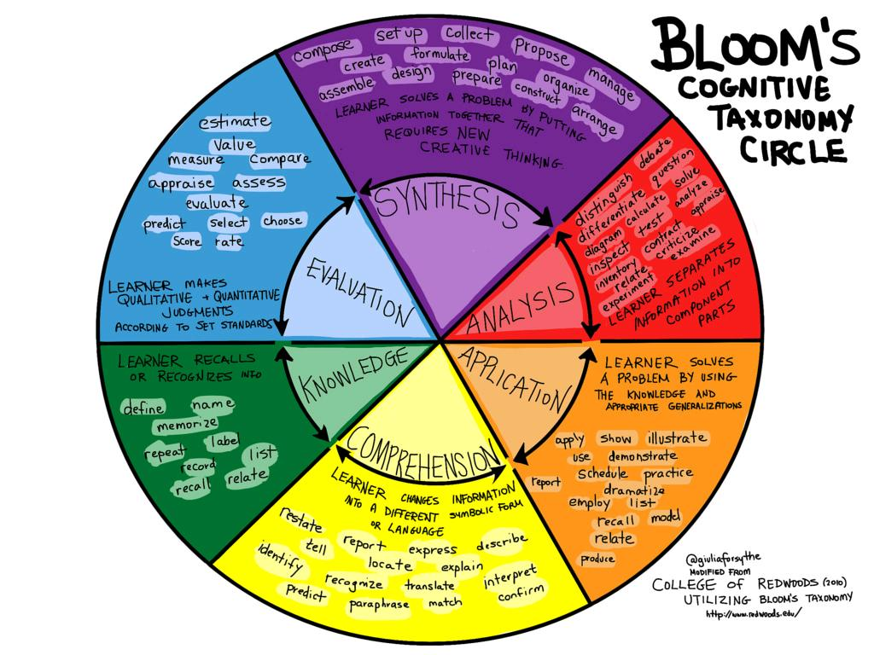
Institutional Learning Outcomes
College of the Redwoods
FLEX 2017
cc: giulia.forsythe - https://www.flickr.com/photos/59217476@N00

Slide 2
ILO 1: Academic and Career Technical Objectives
Students will successfully acquire program outcomes and complete degrees and/or certificates. This institutional outcome indicates if the objectives stated for degrees and/or certificates are being met. Students earning degrees will acquire the College’s general education outcomes.

Slide 3
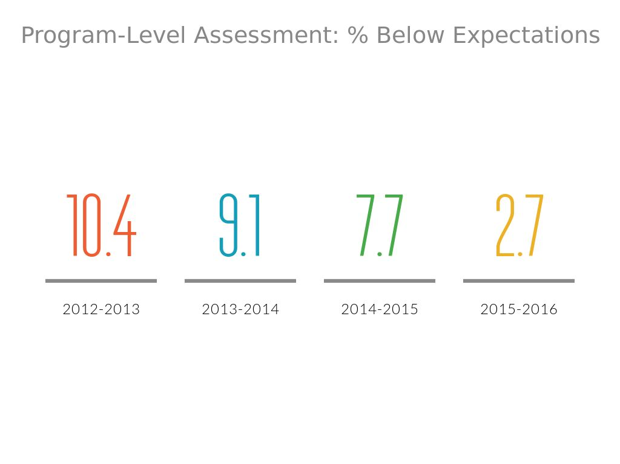

Slide 4
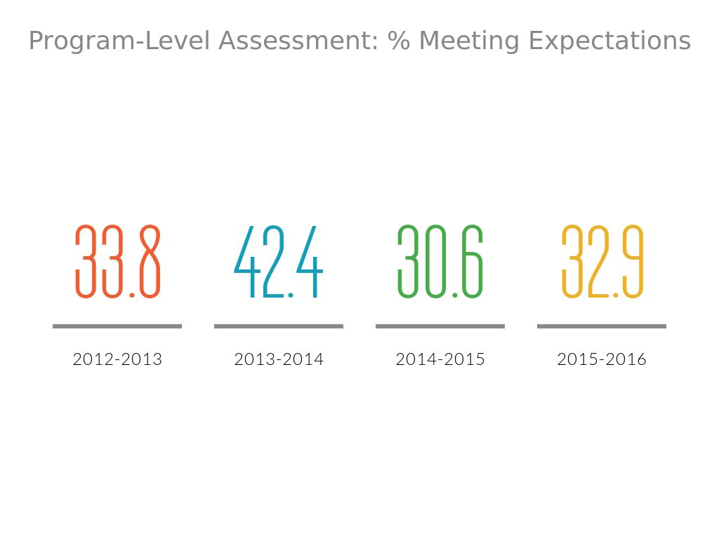

Slide 5
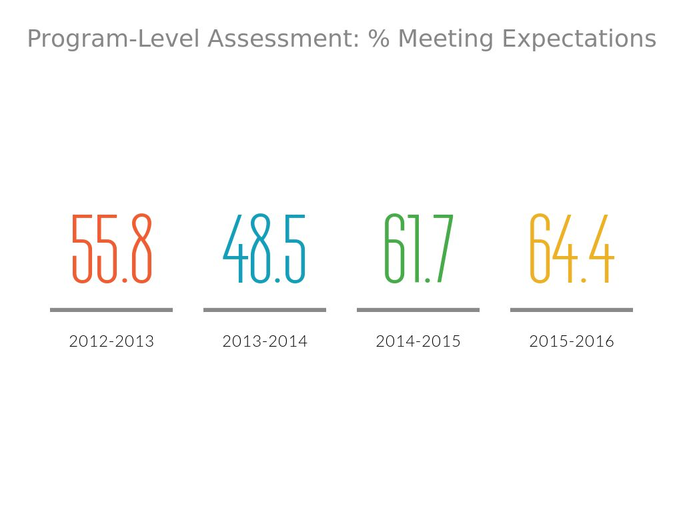

Slide 6
Overall...
Ratings below expectations were most given in CTE

Slide 7
Course Outcomes:
All subjects had at least two-thirds of students meeting or exceeding expectations.

Slide 8

Which Division had the subjects with the most below expectations?

Slide 9
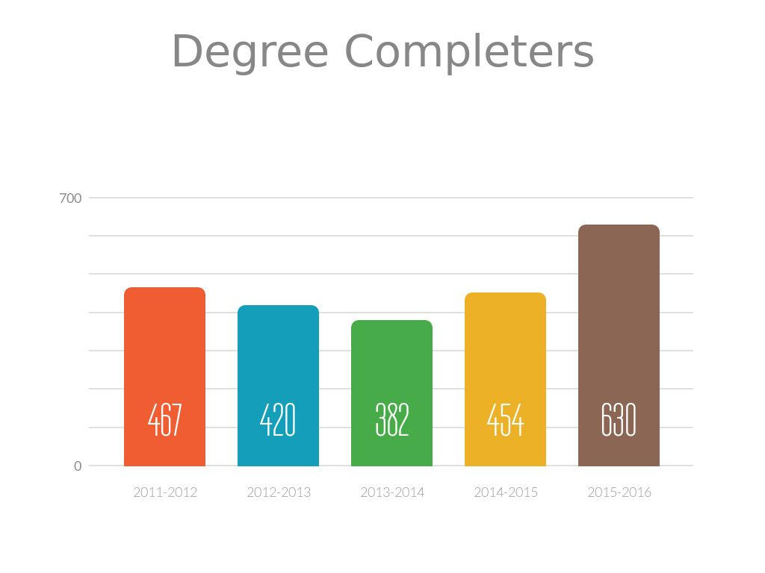

Slide 10
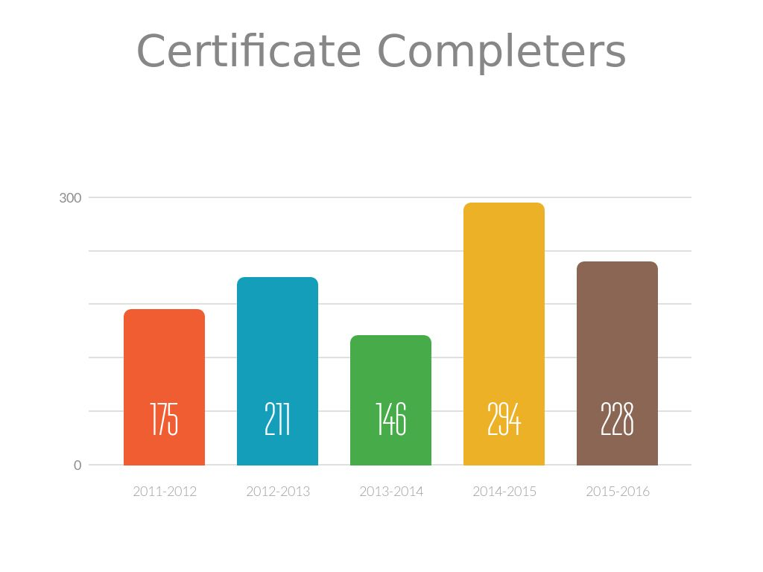

Slide 11
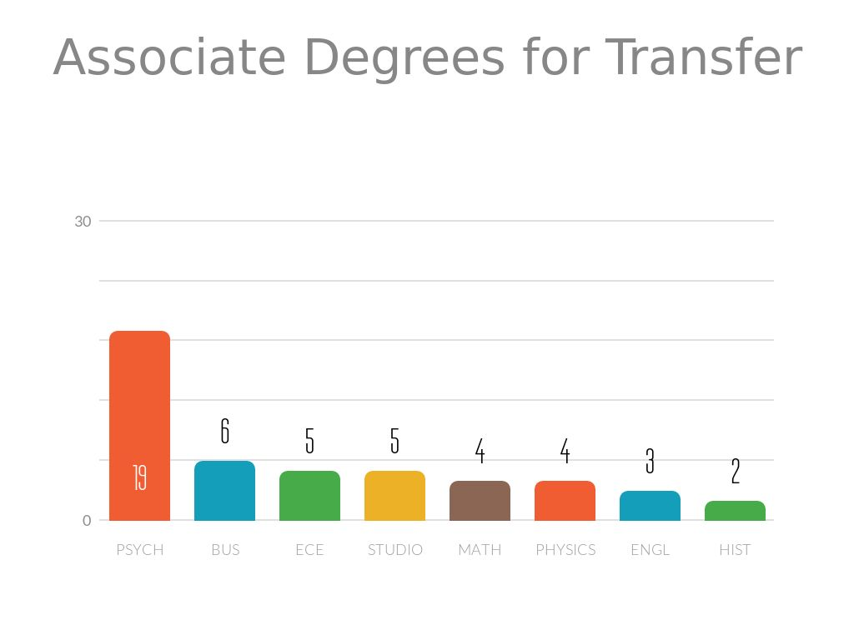

Slide 12
To what extent do you agree CR Prepared you with
the following skills and abilities?
Critical thinking & problem solving = 4.59
Written communication = 4.51
Verbal communication = 4.46
Research & evaluating data = 4.46

Slide 13
To what extent do you agree CR Prepared ..
Being safety minded in the workplace = 4.05
Reading = 4.03
Scientific reading = 3.97
Computing & technology = 3.68

Slide 14
ILO 2: Students will reach their career, transfer, or personal goals. This outcome indicates if a student's individual goals are being met. This includes the goals of students earning degrees, or of students taking only a few courses for training and/or personal enrichment.

Slide 15
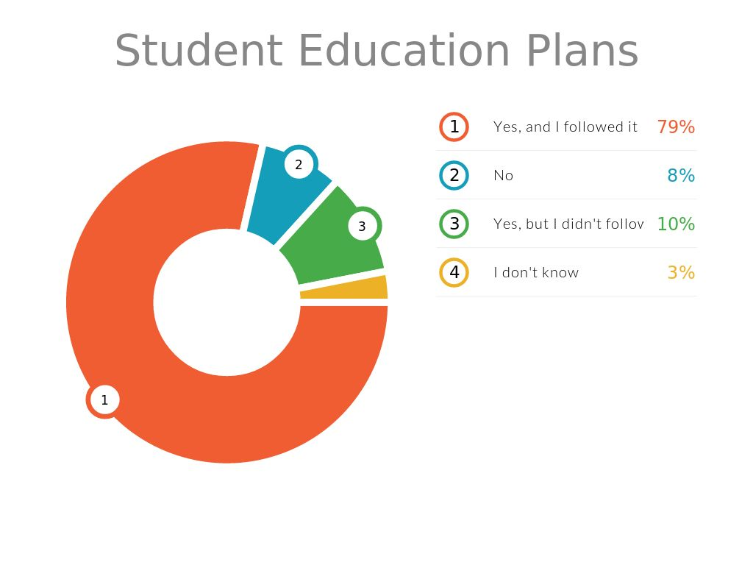

Slide 16
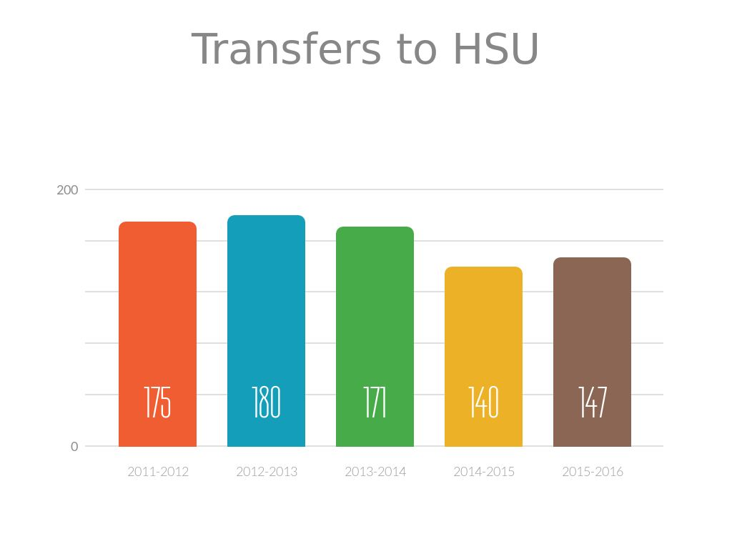

Slide 17
Last year, 89% of transfer students at HSU were not from CR

Slide 18
CTE Outcomes Survey
Administered annually to over 500 CTE skills builders

Slide 19
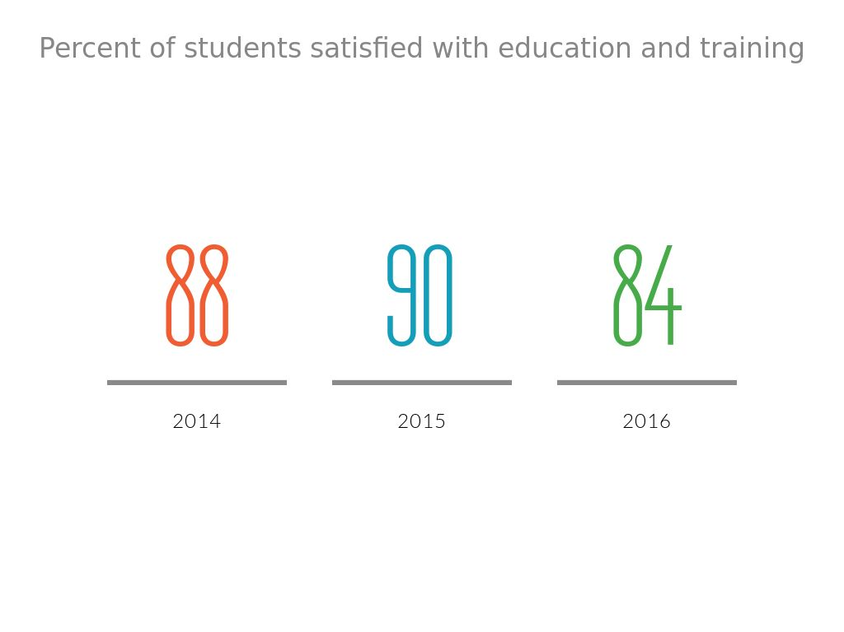

Slide 20
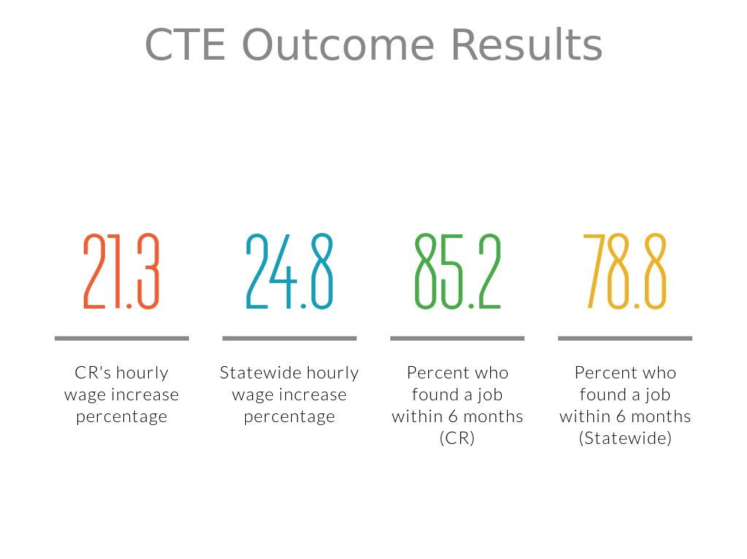

Slide 21
ILO 3: Students will develop the awareness and skills needed to contribute to local and global communities. This
outcome indicates if students recognize ways to contribute to their community and the value of effectively
engaging in cross-cultural environments.

Slide 22
Graduating Exit Survey
To what extent do you agree with the following:
  My overall educational experience was excellent = 4.46
  The quality of academic programs is excellent = 4.36
  The quality of student services is excellent = 4.26

Slide 23
Graduating Exit Survey
  CR helped me reach my transfer goals = 4.16
  Being a student at CR increased my awareness of diverse student groups = 3.69
  Campus activities and services made me more aware of diverse perspectives = 3.61

Slide 24
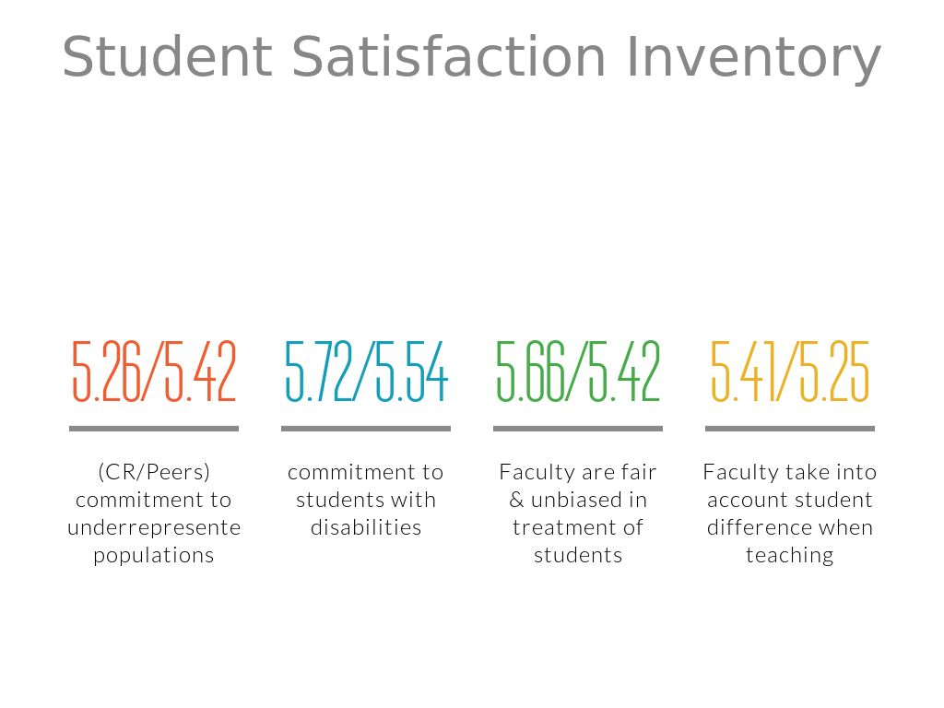

Slide 25
The Diverse Learning Environments Survey (DLE) captures student perceptions regarding the institutional climate, campus practices as experienced with faculty, staff, and peers, and student learning outcomes.
The Cooperative Institutional Research Program (CIRP) is a national longitudinal study of the American higher education system. It is regarded as the most comprehensive source of information on college students.

