Slide 1
Institutional Learning Outcome Dialogue:
Personal & Professional Development
College of the Redwoods
Convocation 2017

Slide 2
ILO 2: Personal and Professional Development
Students will reach their career, transfer, or personal goals. This outcome indicates if a student's individual goals are being met. This includes the goals of students earning degrees, or of students taking only a few courses for training and/or personal enrichment.

Slide 3
Noel Levitz
Student Satisfaction Inventory
This school does whatever it can to help me reach my educational goals. Importance satisfaction/SD Gap
  2017 administration: 6.46 5.41/1.57 1.05
  2013 administration: 6.37 4.97/1.74 1.40
  2010 administration: 6.41 5.31/1.84 1.10
scale of 1 = no importance/lowest satisfaction, 7 = very important/very satisfied

Slide 4
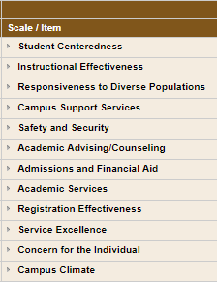
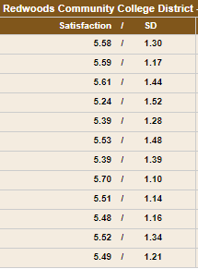
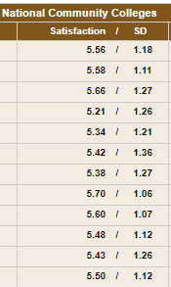
SSI Scale Report: CR vs. National

Slide 5
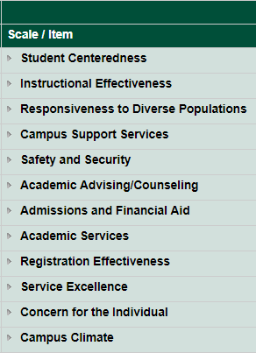
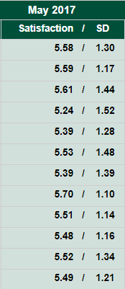
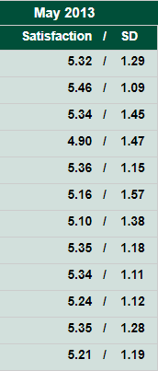
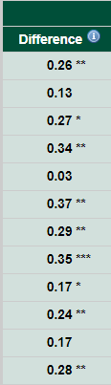
CR 2017 vs. 2013

Slide 6
Graduating Exit Survey
64 student completed the new online graduating exit survey in 2016-2017

Slide 7
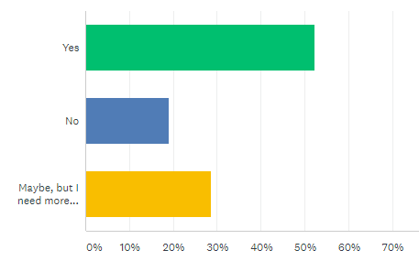
Graduating Exit Survey
Do you plan to transfer to another institution?

Slide 8
Graduating Exit Survey
How important was each of the following in terms of your reason for choosing CR?
 | Weighted Average
Low cost: CR is affordable | 4.89
Quality: CR has good faculty and instruction | 4.8
Availability of major: CR offers the educational programs I needed/wanted | 4.5
Location: CR has a good/convenient location | 4.3
Reputation: CR has a good reputation | 4.15

Slide 9
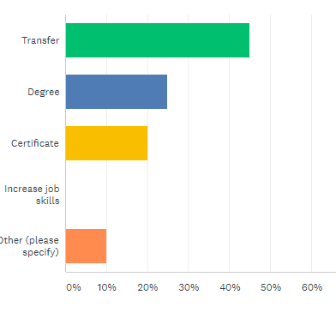
Graduating Exit Survey
What was your main educational objective at CR?

Slide 10
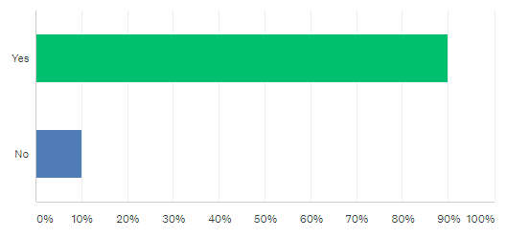
Graduating Exit Survey
Were you successful at completing your main educational objective?

Slide 11
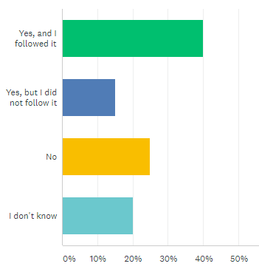
Graduating Exit Survey
Did you have a Student Education Plan (SEP)?

Slide 12
To what extent do you agree CR prepared you in the following skill areas?
 | Weighted Average
Skills specifically related to your degree or certificate | 4.55
Critical thinking & problem solving | 4.53
Research & evaluating data | 4.42
Verbal communication | 4.35
Written communication | 4.2
Awareness of a diverse global community | 4.2
Scientific reasoning | 4.05
Ethical decision making | 4
Reading | 3.95
Math | 3.95
Computing & technology | 3.9
Professionalism (punctuality, time management, etc.) | 3.8
Being safety minded in the workplace | 3.8

Slide 13
Ed Plans cont.
Semester | Comprehensive SEPs reported
2014 Fall | 361
2015 Spring | 610
2015 Summer | 218
2015 Fall | 517
2016 Spring | 488
2016 Summer | 135
2016 Fall | 223
2017 Spring | 272

Slide 14
Transfers
CSUs ~ Dropped from 220 in 2012-13 to 180 in 2015-16
  147 went to HSU in 2015-16
  7 students went to UCs in fall 2015

Slide 15
Transfers
Fall 2016 most popular HSU majors
  Business 17
  Psychology 14
  Biology 14
  Environmental Studies/Engineering 14
  Social Work 12

Slide 16
Associate Degrees for Transfer
Anthropology – 4
Communication - 4
Business Administration - 12
Early Childhood Education - 4
English - 2
History – 4
Kinesiology - 1
Mathematics – 3
Political Science - 1
Psychology – 17
Physics - 2
Studio Arts – 3
Sociology - 7

Slide 17
Student Equity Outcomes
In 2012-13, equity gaps were discovered for access, course success rates, and basic skill success and progression that are not present in the 2015-16 data.
Equity gaps remain for persistence, completions, and transfers in 2015-16.
African Americans again show very low completion rates. Hispanics were disproportionately impacted in 12-13 but not in 15-16.

Slide 18
Student Equity Outcomes
Gender | Degree/Cert Seeking Cohort | Completers | Completion rate | Ratio
Female | 2347 | 560 | 0.24 | 1.32
Male | 2067 | 375 | 0.18 | 1.00
Age
< 25 | 2661 | 489 | 0.18 | 1.00
25-34 | 1112 | 288 | 0.26 | 1.41
35-49 | 465 | 127 | 0.27 | 1.49
50 and above | 176 | 31 | 0.18 | 0.96
Ethnicity
American Indian | 332 | 75 | 0.23 | 1.02
Asian | 121 | 29 | 0.24 | 1.08
African American | 103 | 8 | 0.08 | 0.35
Hawaiian/Pacific Islander | 44 | 7 | 0.16 | 0.72
Hispanic | 666 | 121 | 0.18 | 0.82
Two or More Races | 291 | 59 | 0.20 | 0.91
Unknown | 272 | 63 | 0.23 | 1.04
White | 2585 | 573 | 0.22 | 1.00

Slide 19
CTE Outcomes Survey
Skills-building students were surveyed if they met one of the following criteria in 2013-2014, and did not enroll in 2014-2015:
  earned a certificate of 6 or more units, earned a vocational degree, or
  earned 9+ CTE units
The survey was administered in early 2016 by e-mail, telephone and US mail.

Slide 20
CTE Outcome Survey
266 students responded of 529
Why did you stop taking classes at CR?
  My goals were met (123)
  I completed the program (114)
  I got a job (80)
  Relocation (54)

Slide 21
CTE Outcome Survey
Primary reason for attending

Slide 22
CTE Outcome Survey
49.6% were “very satisfied” with the education and training they received at CR, and 33.8% were “satisfied” for an overall satisfaction rate of 83.5%.
23.3% of respondents indicated they had transferred to another College or University.

Slide 23
Current Employment Status

Slide 24
If currently employed:
55.1% indicated they are working in the same field as their studies and training, followed by
20.6% indicating they work in a field that is “close” to their studies and training,
24.3% indicated their job is not related to their studies.

Slide 25
Employment
Of those respondents who engaged in a job search after finishing their studies
  84.0% reported finding a job and
  16.0% were still looking.
  Of those with a successful job search, 86.7% found a job within six months (65.7% within three months).

Slide 26
Work status before and after CR

Slide 27
Work status before and after CR
The hourly wage of all respondents increased 35.0% from their hourly wage before their studies

Slide 28
CTE Outcome Survey
Respondents, including those who had transferred, were asked what impact their coursework had on their employment.
  No impact on my employment (72)
  Enabled me to learn skills that allowed me to get a job at a new organization (58)
  Prepared me for a possible new job (54)
  Enabled me to learn skills that allowed me to get a promotion at my same organization (24)
  Enabled me to learn skills that allowed me to stay in my current job (19)
  Enabled me to start my own business (11)

