Slide 1
SLO Assessment Workshop Student Development
College of the Redwoods
June 8, 2016

Slide 2
Creating SLOs
Start by looking at your department/service area mission statement.
  What are the most important things a student should know, be able to do/demonstrate after utilizing my services?

Slide 3
S.M.A.R.T.
Specific- focus on specific category of student learning
Measurable-data can be collected to measure learning
Appropriate- worthwhile to student
Realistic – within your control to effect
Time limited – contained within year or appropriate amount of time

Slide 4
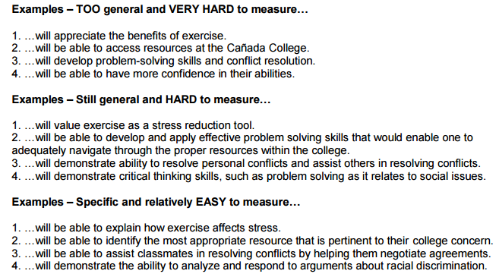
Creating SLOs
Examples from Canada College

Slide 5
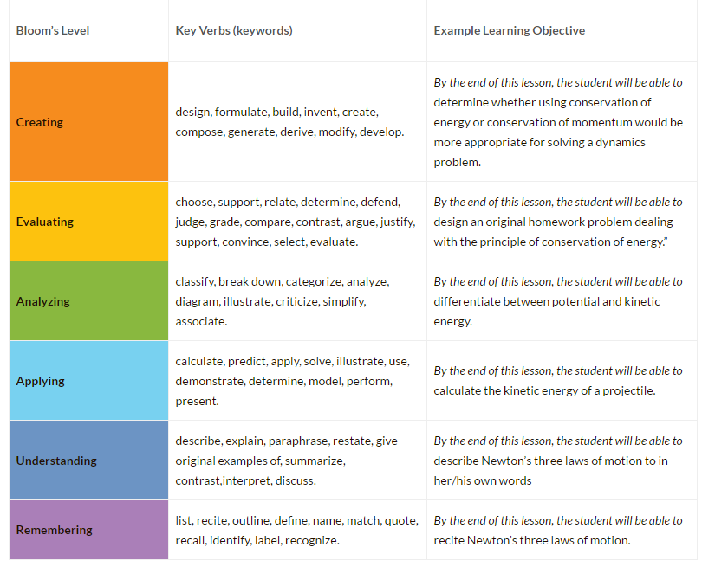

Slide 6
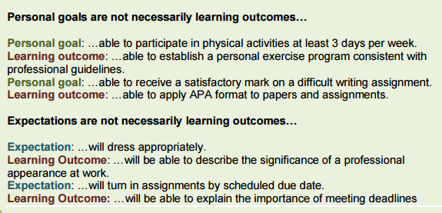
Creating SLOs

Slide 7
Creating SLOs
Students will understand the reasons for creating a Student Education Plan.
  Good SLO?
  Can it be measured? Can learning be demonstrated?

Slide 8
Creating SLOs
Students will understand the reasons for creating a student education plan.
  How can we make it easier to measure?

Slide 9
Creating SLOs
Students will arrive on time to their counseling appointments.
  Good SLO?
  Can it be measured? Can learning be demonstrated?
  How can we make it better?

Slide 10
Creating SLOs
Fill in the blank for your program.
  As a result of students participating in __________, they will be able to __________.

Slide 11
Assessment Instruments
Students will be able to identify the most appropriate resource that is pertinent to their [college concern].
  How would we measure this?

Slide 12
Assessment Instruments
Surveys with one or more questions asking students the extent to which they agree that the service resulted in the outcome.
Example: To what extent do you agree that counseling services: (1) made it possible for you to describe reasons for developing a student education plan? (2) gave you the knowledge to determine which courses to take to meet general education requirements.

Slide 13
Assessment Instruments
Short questions asked during orientation, related classes, one-on-one meetings, etc.
Examples:
  Select the best reasons for developing a student education plan.
    A) to receive financial aid, b) to ensure meeting your educational goal, c) to get extra credit
  What English course is needed for an Associate’s Degree? __________

Slide 14
Assessment Reports
Everyone demonstrated the outcome. All is good.

Slide 15
Assessment Reports
Demonstrate plans for improvement based on assessment results so that you can include them in program review, and link to resources.

