Slide 1
Referring Students to the
Behavioral Intervention Team (BIT)
Notes:
Hello & Intro - Katrina and Stephanie

Slide 2
Learning Objectives
Increased ability to recognize signs of academic, emotional, and social challenges in students in order to intervene proactively.
Improved ability to foster conversations with students about available resources.
Proficiency in using our referral platform.
This session is in direct support of EMP Initiative #4: Establishing Stronger Wraparound Experiences for Students’ Total Connection.
Notes:
Stephanie

Slide 3
Why are Referrals Important?
Shows students that take their situation seriously and care about them as individuals.
Ensures that someone will follow up with the student and connect them to the appropriate resources.
Going through the referral process raises awareness about campus resources and empowers students to seek help proactively in the future.
Notes:
Stephanie

Slide 4
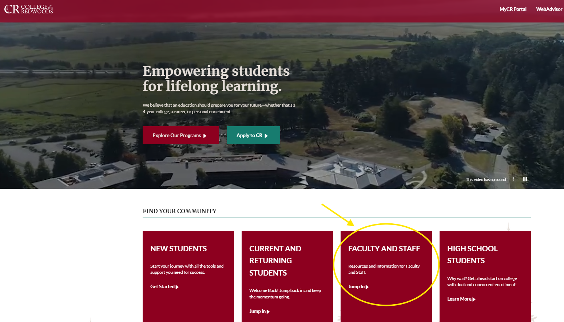
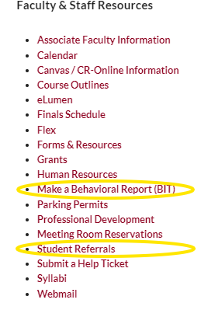
How to Make a Referral
Notes:
Stephanie

Slide 5
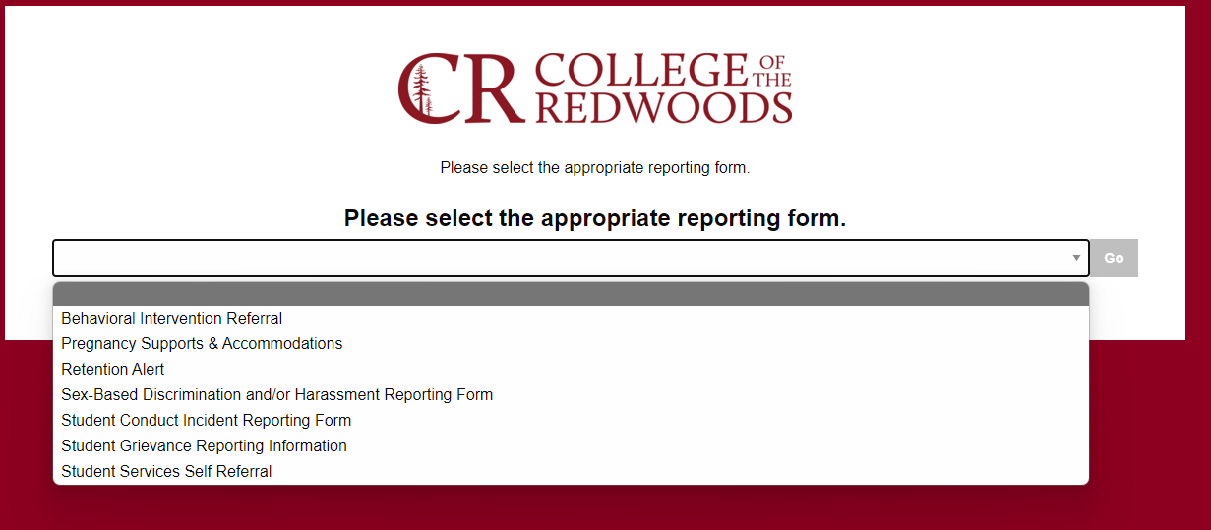
Select Appropriate Referral Form
Notes:
Stephanie

Slide 6
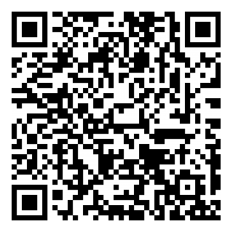
How to Make a Referral
https://cm.maxient.com/reporting.php?Redwoods
Notes:
Stephanie

Slide 7
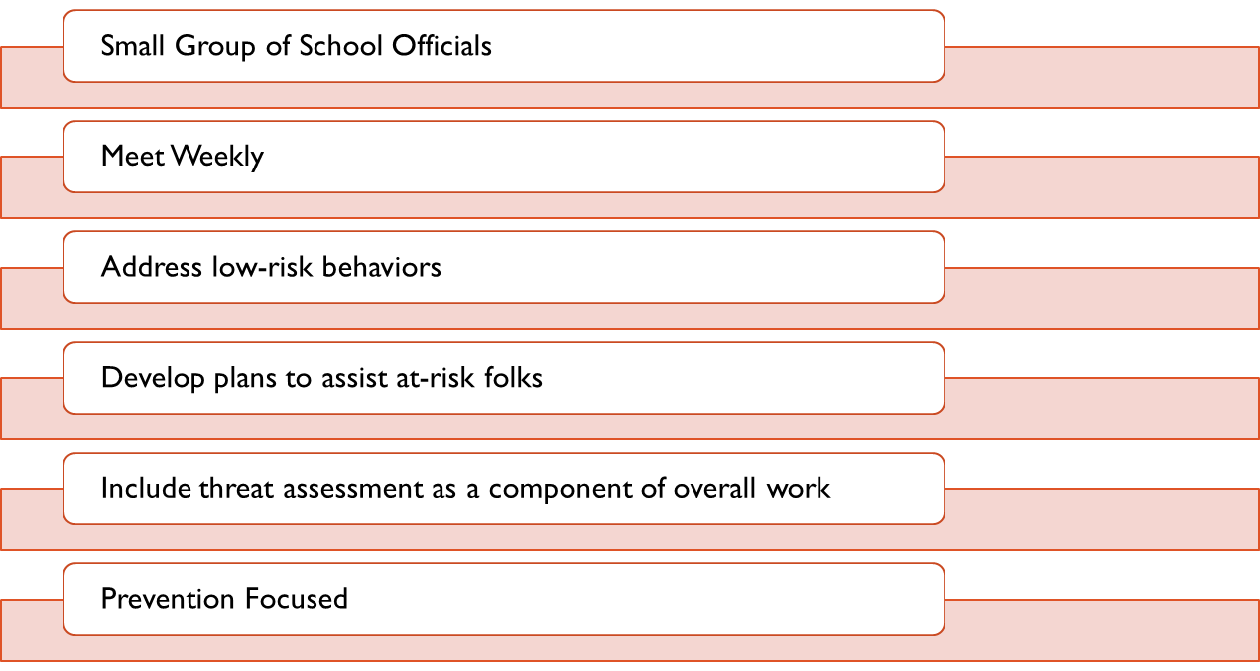
What is BIT?
Notes:
Stephanie

Slide 8
Who is BIT?
Directors & Managers
Residential Life
Student Conduct
Title IX
Athletics
Special Programs
Counseling/Advising
Pelican Bay
VP
Campus Safety
SASS
Classified
Confidential Staff
Eureka, KT & DN

Slide 9
Mission Statement
The Behavior Intervention Team (BIT) strives to promote individual student wellbeing and success while prioritizing community safety. BIT is a support mechanism and safety net for students experiencing difficulties or exhibiting concerning behaviors. The goal is to seek solutions and interventions that will support the student and prevent disciplinary action.
Anyone can make a referral to BIT.
Notes:
Stephanie

Slide 10
What is Our Scope?
BIT receives referrals and addresses behavior along the spectrum of risk to decrease distress, increase wellness, and prevent violence. BIT meets weekly to discuss new referrals and create individualized intervention plans for students.
BIT addresses concerns including but not limited to, disruptive or concerning behaviors; difficulty accessing resources and addressing basic needs; academic distress; or personal, emotional, and/or psychological difficulties; and harm to self or others. The team incorporates violence risk and threat assessment to inform interventions and reduce bias.
Team members provide ongoing wraparound support to students experiencing difficulties from intake to resolution. BIT assesses outcomes through detailed recordkeeping to inform future process improvements.
Notes:
So let’s take a look at our scope, just kidding our scope was lost over the years on our website. Which is funny because I very much remember it being on our webpage at one point and now it’s not. I looked back though my various documents for updating websites over the years and found this, which seems like a good starting point:
BIT meets weekly to discuss new referrals and create individualize intervention plans for students. As BIT will continue to be in communication with staff and faculty, as confidentiality allows, throughout the process. The goal is to support the student, staff and faculty throughout until the issue at hand has been maximally addressed.
Is there anything we would like to add or change?

Slide 11
Fall 2024 Stats
We received 85 intake reports!
Scheduled 69 Counseling Appointments
Performed RA for over 50 cases.
Developed 48 Intervention Plans
Performed 20 Faculty Check ins
Made 91 referrals to on and off campus resources.
Most Common Causes for Concern:
Heightened Emotional Stress (36)
Concerning Behavior (25)
Depression (25)
Family Stress (24)
Anxious Behavior (17)

Slide 12
The BIT Process
Referral Received & Review
Meeting Operations
Objective Risk Assessment
Interventions
Case Management
Case Review
Close Case

Slide 13
Receiving a Referral
All referrals from the intake form initiate an email to the entire BIT Team
Team begins information sharing immediately
Preliminary risk assessment made by co-chair
Actions taken based on preliminary assessment
Notes:
What happens when we get a referral from the referral page? When submitted the Intake Report shows up on my dashboard and initiates an email to the entire BIT team. If you are not getting those emails, please let me know ASAP.
Based on what we talked about yesterday, Stephanie will reach out to the student and or referral source if needed and team members will provide information via email if they have it. Based on what is collected, I will turn the intake form into a case in Maxient.
If you enter your cases directly into Maxient (not using the intake form on the website) please make sure you add Stephanie as a collaborator on the “Case” tab. I will go over what that looks like in a few minutes.

Slide 14
Meeting Intake for New Cases
Gather Data
Assess Risk
Deploy Interventions
During Team Meetings BIT:
Reviews each new cases
Collect more information from the group
Make an assignment
Complete Risk Assessment
Notes:
To start meetings, we will review incoming cases, college information from the group, make an assignment and complete the risk assessment. This will be followed by our normal case reviews.

Slide 15
Objective Risk Assessment
BIT Utilizes the National Association for Behavioral Intervention and Threat Assessment’s (NABITA) Risk Rubric to assess each students referred to BIT.
Assign an initial risk rating to each new case and update as more information is gathered.
Document all risk ratings including a rationale.
The team considers multiple perspectives when assessing risk to reduce bias.
Intervention plans are consistent with risk level.

Slide 16
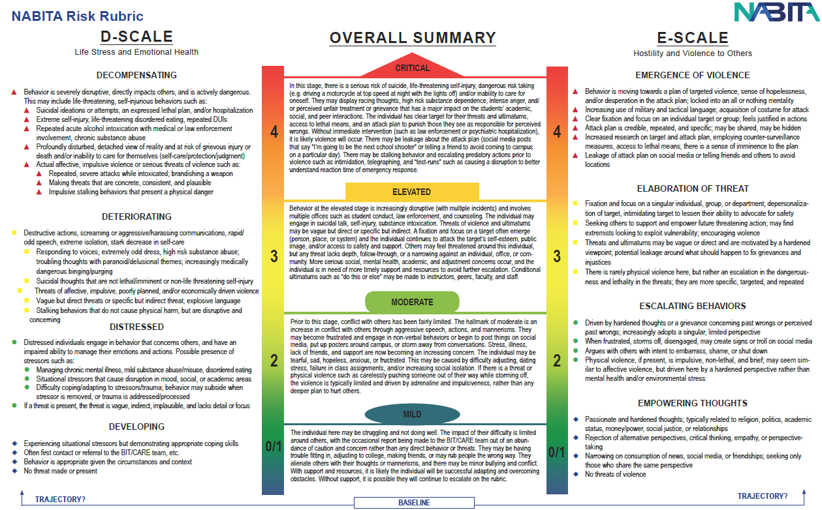
Objective Risk Assessment

Slide 17
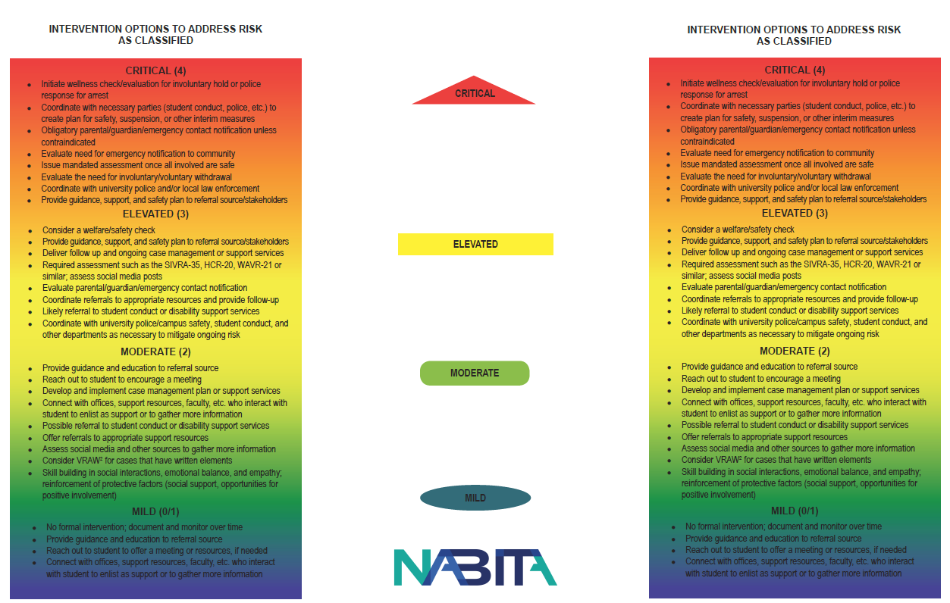
Interventions
Notes:
Side 2 of the risk rubric is the associated interventions which we will discuss and choose from for cases.

Slide 18
Intervention Plan
Interventions are chosen based on risk level and data gathered by the BIT Team.
Duration and frequency of interventions aligns with level of risk
Interventions are updated and adjusted as more information is gathered.
Interventions are NOT punitive or disciplinary. BIT cannot remove students from class (unless there is an immediate threat to safety). They can refer case to student conduct.
Notes:
Moving along to intervention plans. They will be developed collaboratively during meetings after the risk assessment has bee completed. They will align with the NABITA recommendations.
Intervention plans will be documented by the assigned team member in Maxient under “tasks” and progress will be documented in case notes.

Slide 19
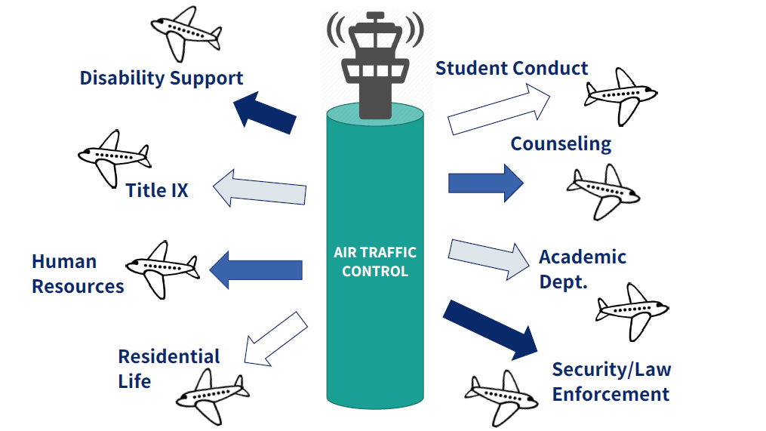
Managing BIT Cases
Notes:
This graphic just reiterates the role of the case manager who acts at the “air traffic controller” for the student. They facilitate necessary referrals and taking steps to support the student.

Slide 20
Interventions
Interventions might include:
Initial Outreach Call Initial Case Intake Conflict Mediation Counselor Check-in Counseling Appointment Ongoing Counseling General Case Management Faculty Touch Base Faculty Check-in Housing Check-in Intervention Plan Developed | Crisis Plan Developed Parent/Guardian Meeting Release form filed Wellness Check Social Media Check Welfare Check NABITA Risk Rubric – D-Scale NABITA Risk Rubric – E-Scale Case Closed Case Re-Opened Referral to Basic Needs Center | Referral to SASS Referral to Special Program Referral to Student Conduct Referral to Academic Counseling Referral to Timely Care Referral to External Counseling Referral to Human Resources Referral to Retention Coordinator Referral to Career Center
Notes:
In Maxient we currently have the following menu of interventions. We will go about how to use these on Monday.

Slide 21
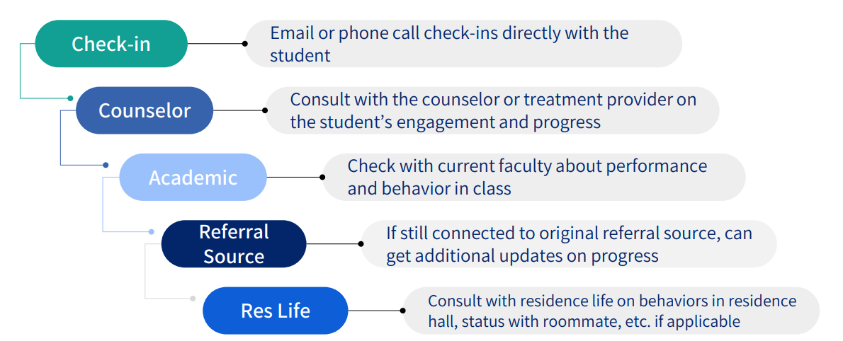
Common Monitoring Plan Elements

Slide 22
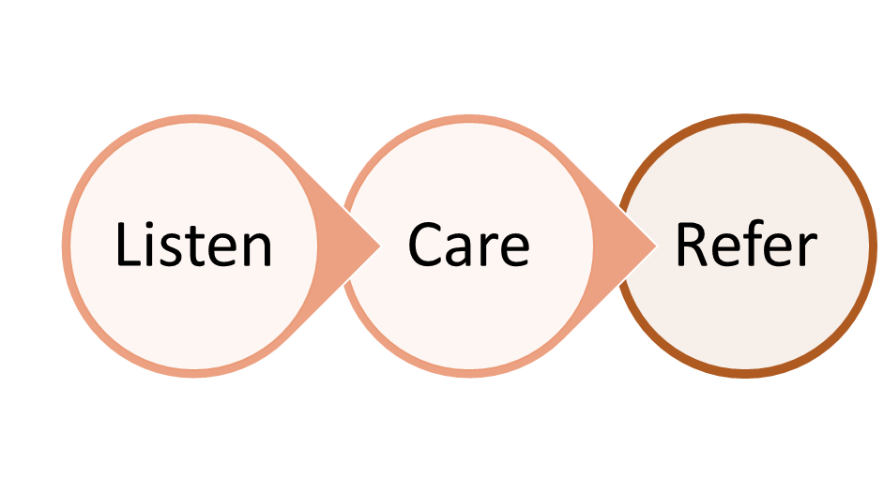
How Can We Help Students In Distress
Notes:
Stephanie

Slide 23
Recognizing the Distressed Student
Proactively tell students about campus resources: syllabus, first day of class, and reminders throughout the term to encourage them to seek support.
Faculty and staff may be the first to notice a student who is struggling due to sudden changes in behavior or performance.
Students in distress may reach out to faculty and staff members for help.
Some students may be more inclined to isolate and withdraw. They may suddenly stop coming to class and not respond to communication.
Notes:
Katrina

Slide 24
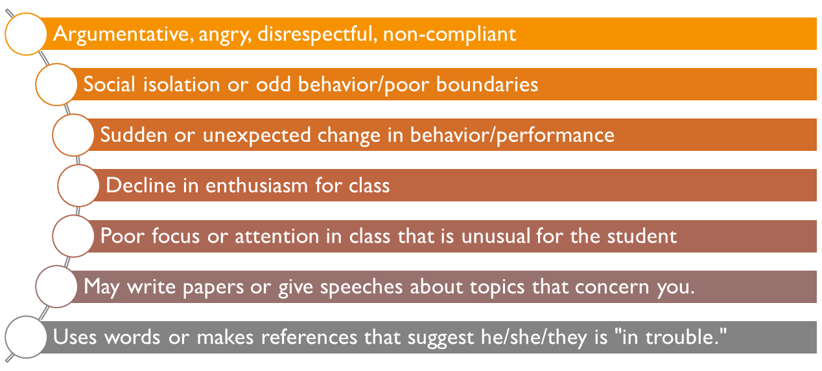
Behaviors That Indicate Stress & Distress
For an immediate response, please call Public Safety at x4111.
Notes:
Stephanie

Slide 25
How Can We Help Students In Distress
Faculty and Staff do not have to take the role of counselor or diagnose students.
If you are comfortable you can speak with the student in private
Acknowledge your observations, while staying neutral
Express concerns directly and honestly
Don’t use this as an opportunity to teach, give a life lesson, or give advice.
Listen and use empathy.
Involve yourself only as far as your feel comfortable.
Make the necessary referral.
Notes:
Stephanie

Slide 26
You are NOT expected to be a counselor. You are expected to:
Listen
This helps them feel grounded and safe before offering a resource or referral.
Care
“I believe you.” “That sounds hard.” “You don’t deserve that.”
Refer (or warm handoff to a resource)
Document what they tell you. Maintain confidentiality.
Self-Care: Dealing with a distressed student can be emotionally taxing.
Notes:
Katrina

Slide 27
You ARE also expected to:
Proactively manage your classroom –
Clearly outline classroom behavior expectations and boundaries in your syllabus. Refer back to them as necessary
Address inappropriate behavior immediately
Be empowered to remove any student who is not following behavioral expectations even after corrective measures
Maintain a basic knowledge of District policies and procedures related to student conduct.
Maintain a basic knowledge of on campus resources for students.
Make the appropriate referrals and notify your Dean or Director.
Notes:
Katrina

Slide 28
Referrals to Primary & Mental Health Care
College of the Redwoods no longer has an onsite student health center. Services have transitioned to TimelyCare, which connects students with 24/7 access to free mental and physical healthcare.
Campus Safety First Aid & Emergency Support: 707-476-4111
Wellness Vending Machine (LRC Breezeway): low cost and free OTC supplies
Notes:
Katrina

Slide 29
Training Resources
Keenan https://redwoods-keenan.safecolleges.com/login
Go 2 Knowledge https://www.go2knowledge.org/learn/
Vision Resource Center https://vrc.cccco.edu/
Notes:
Stephanie

Slide 30
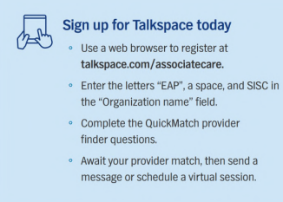
Employee Assistance Program
Notes:
Stephanie

Slide 31
Have More Questions?
Jennifer Bailey - BIT Coordinator
Jennifer-bailey@redwoods.edu
707-476-4137
Stephanie Freyermuth - BIT Administrative Support
stephanie-freyermuth@redwoods.edu
707-476-4146
Bob Brown- BIT/Student Conduct
bob-brown@redwoods.edu
707-476-4239
Notes:
Stephanie

Slide 32
Questions?
Notes:
Stephanie

