Slide 1
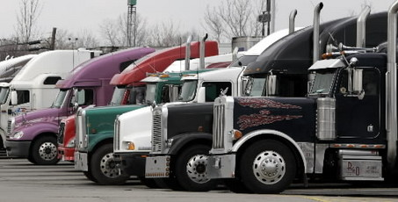

College of the Redwoods
Truck Driving
CDL Training Program

Slide 2
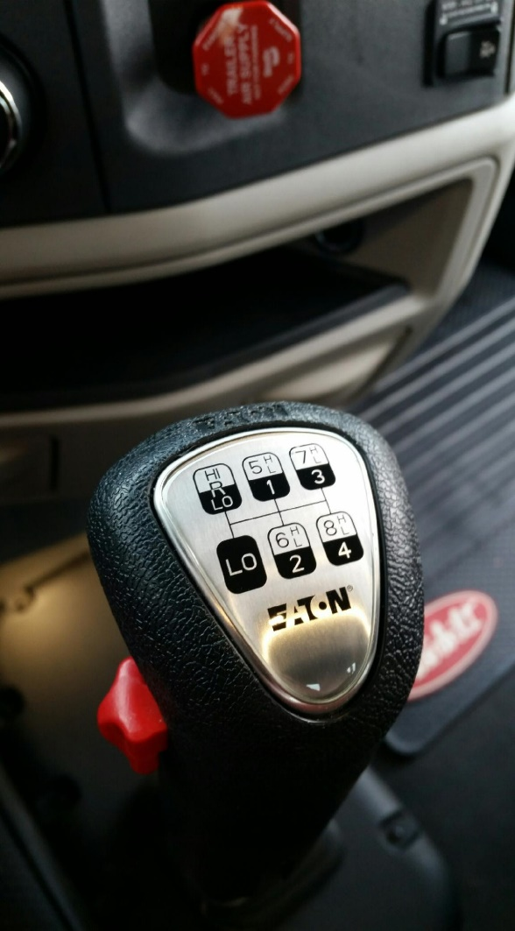
Informational Meeting Agenda
Program dates/location
Application Packet Requirements
Alcohol/Drug Screening
Lottery Drawing
Mandatory Orientation
Driving Test at DMV
Costs/How to pay
Questions

Slide 3
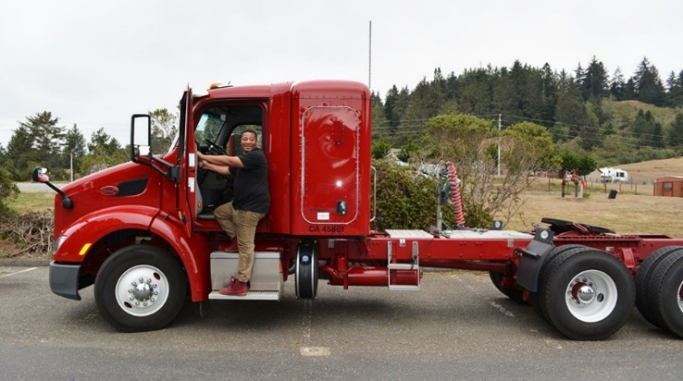
Program Schedule
July 10th – August 7th, 2026
4-week session
Behind the Wheel Training
Driving/Observation Sessions*
Monday - Friday
7:00a – 11:00a or 1:00p – 4:00p
*session timing subject to change
Notes:
Folder Doc – Schedule

Slide 4
Program Location(s)
Online Theory Portion
Entry Level Driver Training (ELDT)
Weekly lessons to complete
Behind the Wheel Training
College of the Redwoods – Main Campus
7351 Tompkins Hill Road
Notes:
Pre-Class – 2 maps

Slide 5
Process Overview
Informational Meeting 6/10/26
Application Period 6/10 - 7/6/26
Lottery 7/6/26
Registration / Payment 7/8/26
Program begins 7/10/26

Slide 6
Application Packet Requirements
All Due by Monday July 6th at 4:00pm
  Completed Truck Driving Program Application
  Current California Driver’s License
  DMV Driving Record
  Certified Medical Examiner's Report
  Class A Learners Permit (3 tests)
      General Knowledge, Air Brakes and Combination Vehicles
  Negative Drug Screening – details provided by The Green Light, LLC
  Release of Information
  Signed Controlled Substance and Alcohol Policy
  Anticipated Funding Source – (If you are being sponsored, a letter from the sponsoring agency is required)
Notes:
Document – do in this order

Slide 7
Alcohol / Drug Screening Information

Slide 8
Lottery Overview
All completed eligible applications will be entered into the drawing on July 6th
Your assigned number for the lottery will be emailed to you if your application is eligible.
First 4 numbers drawn are accepted into the July 2026 session.
Remaining numbers drawn will have “priority registration” for the next three sessions being offered.

Slide 9
Mandatory Orientation Meeting
(Lottery Numbers 1-4)
Friday, July 10th, 2026
5:00pm-6:00pm
527 D street, Eureka CA
Room 102

Slide 10
Driving Test at DMV
Program truck is used for the driving test
Registration for the exam will occur at Orientation
Students are given 3 attempts for the DMV driving test.

Slide 11
Program Info and Costs
Online Theory Portion Completion of all lessons is required Behind the Wheel Training
Driving | 40 | hours
Observation | 40 | hours
DMV Warm-Up & Driving Test | 5 | hours
* CA requires min 15 hours of behind the wheel training
Program Costs Course Fee |  | Cost Breakdown $4500
DMV Driving Record |  | $5
Class A Permit Test |  | $95
Drug Screen |  | $150
DOT Physical Examination |  | $100-200
Truck Driving Total Program Cost (approx.) |  | $4,785 - $4,950

Slide 12
Payment & Funding Confirmation
There are several ways to pay for the program:
Pay in full: Cash, Check, Credit/Debit Card
Pay in installments: Nelnet Payment Plan
Agency Sponsorships(some examples include)
  Department of Rehabilitation
  VA Benefits
  Tribal Affiliation
  We must have documentation from a sponsoring agency naming you as the person being sponsored for the full cost of the program. You are not considered a sponsored student if we do not have this documentation.
Notes:
Folder – Sponsorship Opp and Sponsor Detail

Slide 13
Nelnet Payment Plan
Program | Truck Driving
Course Fee | $4,500
Down Payment | $1,000 PLUS $20 nonrefundable enrollment fee
Monthly payments | $583.33, 6 Payments automatically processed on the 20th of each month
The Nelnet Payment Plan must be setup at time of registration. We will provide you with instructions if you select this payment method. You will not be registered until the payment plan is confirmed.
Notes:
Folder Doc –NelNet info

Slide 14
Questions????
707-476-4500 // ace@redwoods.edu
Office Hours: M – Th 8:30a-4:30p

